Slide 1
Protein
Notes:
Ideas, amino acid content in various foods

Slide 2
Quiz Question 1
What is the major difference between proteins and carbohydrates?
Only carbohydrates can be used for energy
Only proteins are absorbed in the small intestine
Only carbohydrates can enter the TCA cycle
Proteins contain nitrogen, this is rare for carbohydrates
Notes:
D

Slide 3
Quiz Question 2
Vitamin C is required for the synthesis of which protein?
Actin
Myosin
Collagen
Albumin

Slide 4
Quiz Question 3
Tyrosine is synthesized from the essential amino acid phenylalanine. That makes it a…
Essential Amino Acid
Conditionally Essential Amino Acid
Non-Essential Amino Acid

Slide 5
The Protein Macronutrient Unit
Date | Topic | Instructor
Wednesday 10/18 | Introduction to Proteins | Bridges
Monday 10/23 | Digestion and Transport | LaBarre
Wednesday 10/25 | Protein and AA Synthesis | Bridges
Monday 10/30 | Amino Acid Degradation | Bridges
Wednesday 11/1 | Synthesis of Non-Protein Compounds from AA | Anderson
Monday 1/6 | In Class Review | Hisamatsu
Wednesday 1/8 | Protein Exam

Slide 6
Protein Structure and Properties Learning Objectives
Apply your knowledge of amino acid biochemistry to explain why proteins are essential macronutrients
Understand the basic structure of protein
Identify the property that makes an amino acid different from another
Describe different functional roles of protein
Identify the major proteins present in food
Differentiate between the different classifications of amino acids
Understand how nonessential amino acids can become essential
Explain the nutritional requirements of collagen synthesis

Slide 7
Protein is an Essential Macronutrient
Deficiencies in protein, not calories: kwashiorkor
Distended abdomen
Fatty liver
Hair, teeth loss
Anorexia
Physical and Mental Development
Deficiencies in protein and calories: marasmus

Slide 8
Is glucose an essential macronutrient?
Yes
No

Slide 9
What is Protein?

Slide 10
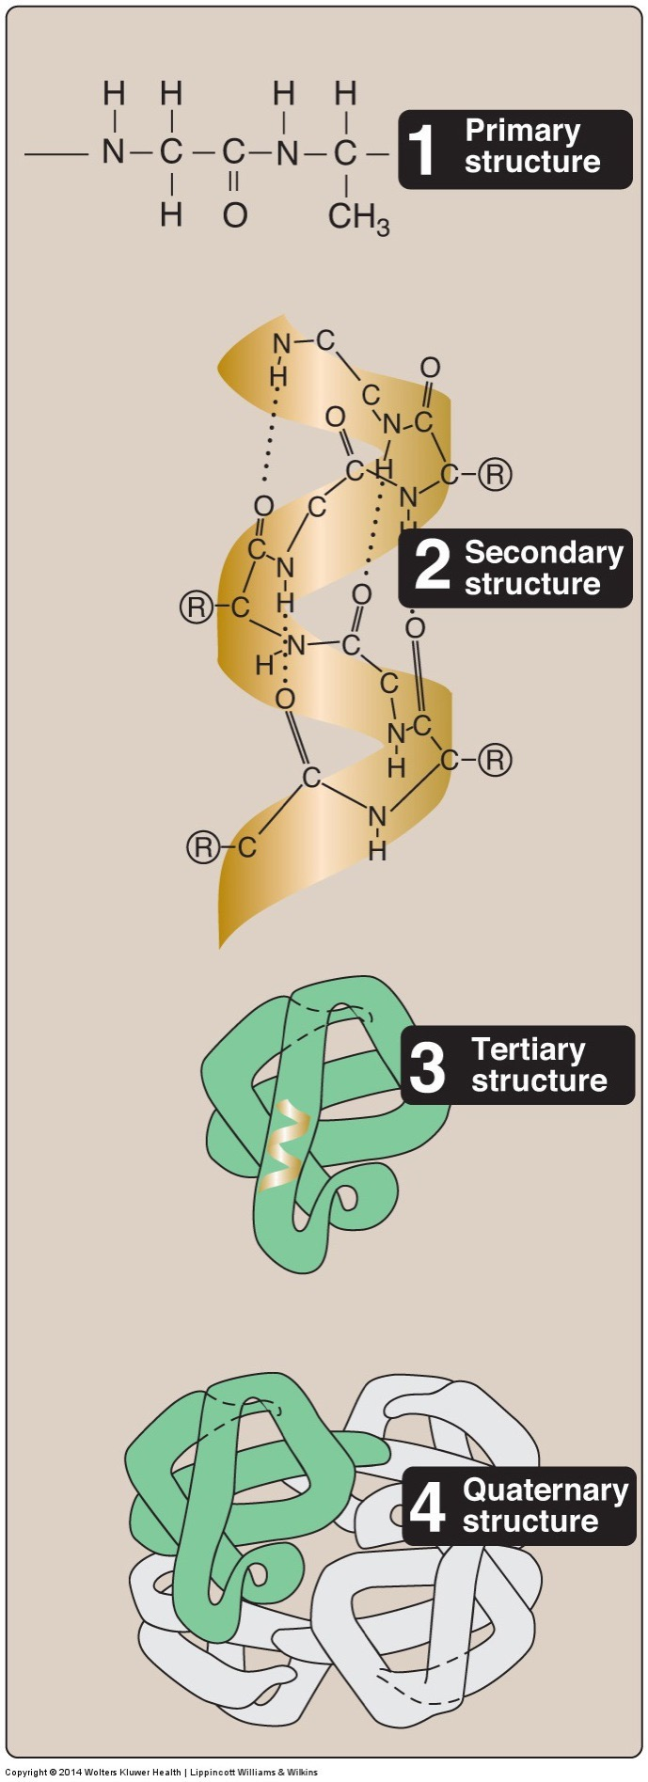
Protein Structure
4 main levels of organization
Primary: Sequence
Secondary: Helices/Sheets
Tertiary: Folds
Quaternary: Multiple Proteins

Slide 11
Proteins are The Source of Food Allergies/Insensitivities
Common food allergens include
Peanuts
Milk (not Lactose intolerance)
Tree Nuts
Fish
Shellfish
Soy
Wheat (ie Gluten)
Affects 4-5% of the population

Slide 12
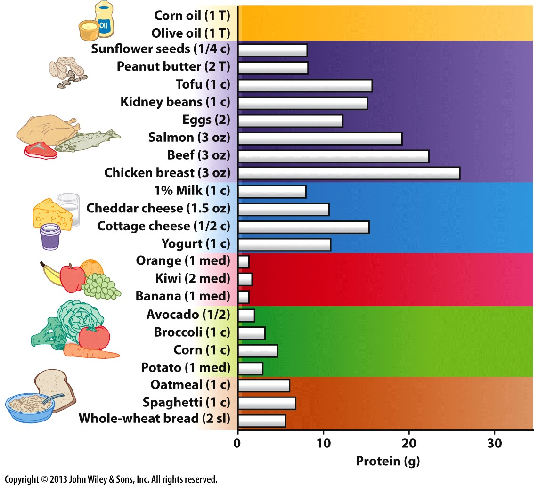

Slide 13
Major Dietary Proteins
Meat
Actin, Myosin, Collagen
Dairy
Casein, Whey
Plants
Gluten
Zea (wheat)
Soy

Slide 14
Endogenous Proteins in Mammals
No generic storage molecule like glycogen or triglycerides
Enzymes, transport proteins, transcription factors etc.
These are required for the normal functioning of the cell
50% of proteins in humans are:
Collagen
Actin
Myosin
Albumin (60% of blood protein)
Notes:
Range in size from 2AA (dipeptide) to Titin (33,000)

Slide 15
The Protein/Amino Acid Pool

Slide 16
Amino Acid Classification

Slide 17
Proteins are Made of Amino Acids (AA)
Proteins made up of amino acids
20 common amino acids
Central alpha carbon
Made of 4 functional groups:
Amino (-NH₂) – contain Nitrogen
Carboxylic acid (-COOH)
Hydrogen (-H)
Side chain (-R)
H
|
H₂N – C – COOH
|
R

Slide 18
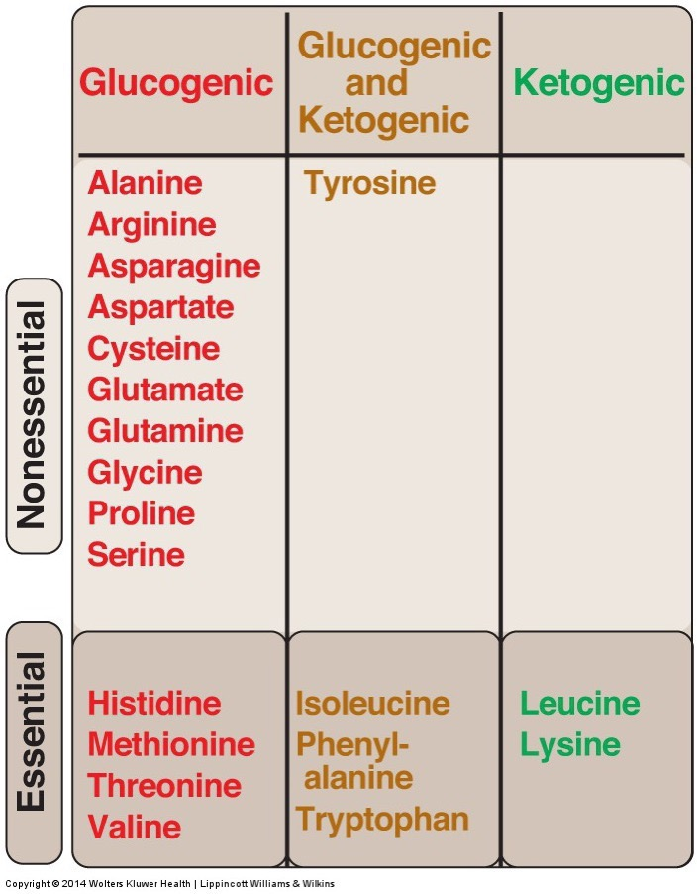
Amino Acid Classifications
Physical Properties (Hydrophobic/Acidic etc)
Biosynthesis (Essential, Nonessential, Conditionally Essential)
Metabolism (Glucogenic, Ketogenic)

Slide 19
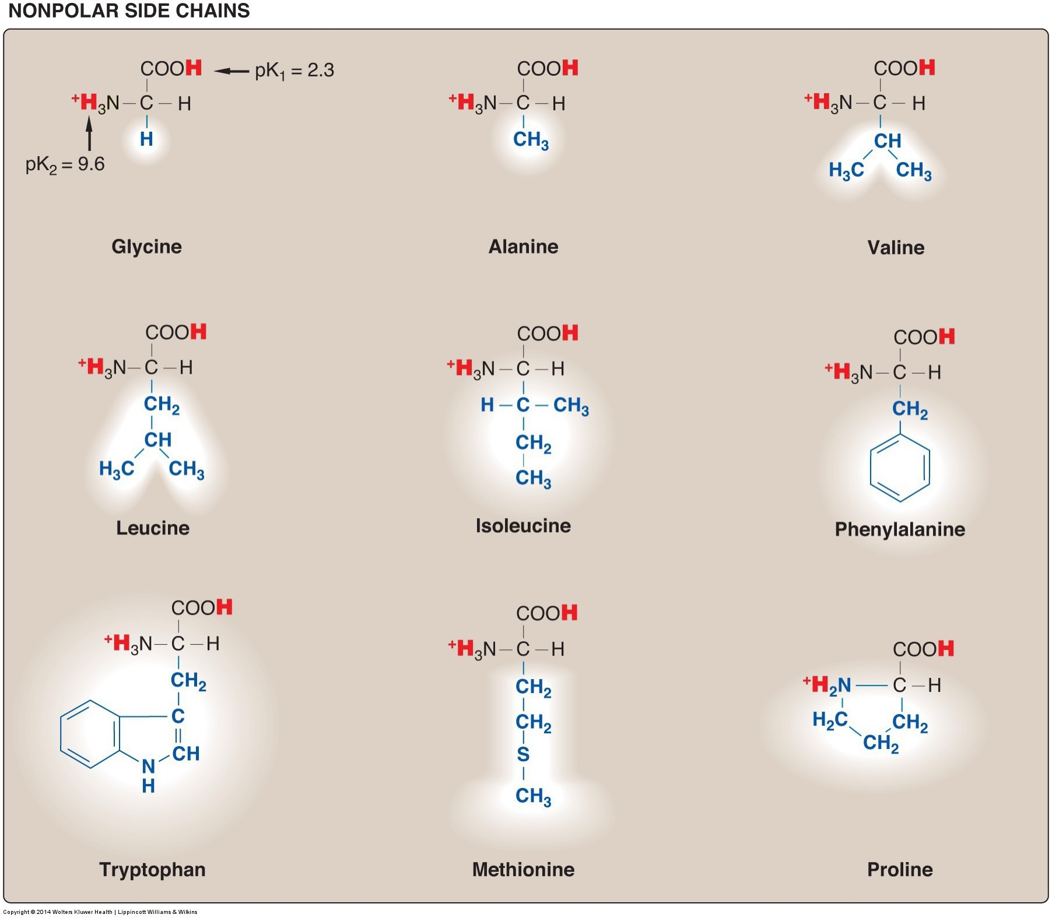
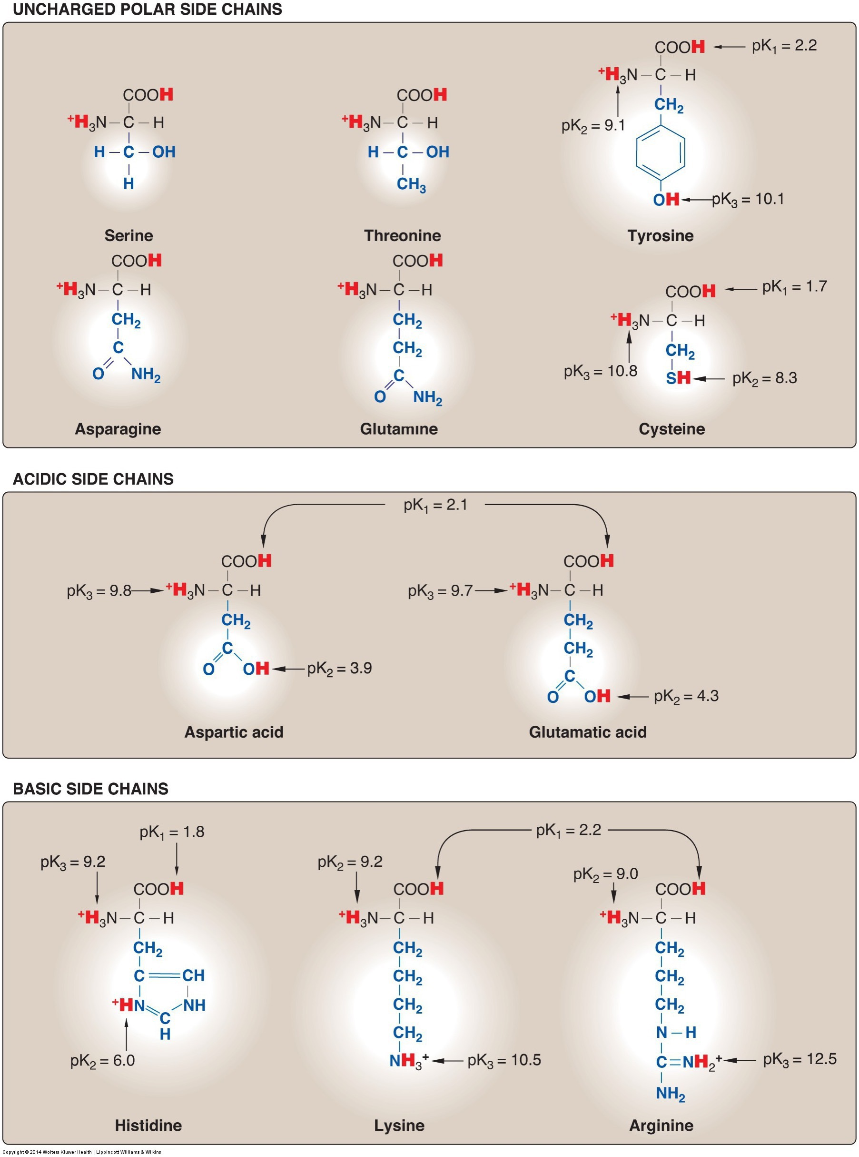
Amino Acids: Physical Properties
Side chains of polypeptide give protein a unique function:
Hydrophobicity
Charge
Positive or negative
Aromatic rings
Hydroxylic group
Sulfur atoms

Slide 20
Amino Acid Classification: Essentiality
Essential – nutritionally necessary
Nonessential/Dispensable – synthesized de novo (in the body)
Conditionally essential – may need from diet due to physiological circumstances
Premature newborn – immature liver
Genetic disorders

Slide 21
TCA Cycle and Amino Acid Biosynthesis
PH
Plants, bacteria and fungi can usually make all amino acids.
Humans have lost this ability
Notes:
A caveat about your biochemistry textbooks

Slide 22
Experimental Determination of Amino Acid Dispensibility
William C. Rose

Slide 23
How Do We Know What is Essential?
It was known that using corn zein protein to feed rats this restricted growth so other AA are needed
Purified and added back all 19 known amino acids, growth restricted
First identification of threonine
Repeated this with graduate students
Notes:
The diets consisted of corn starch, sucrose, butter fat from which the protein had been removed, corn oil, inorganic salts, the known vitamins, and mixtures of highly purified amino acids. The only variables allowed, other than when changes were purposely made in the amino acids consumed, were distilled water and celluflour, a product that provided bulk but had no nutritive value, nitrogen, or flavor. The only unusual component of this otherwise bland diet was a large brown candy containing a concentrated liver extract as a possible source of unknown vitamins, sweetened with sugar and flavored with peppermint oil, which provided a never-to-be-forgotten taste.

Slide 24
Grad School!
“In further investigations with Illinois graduate students as subjects, who were grateful in those days for the free rations, the dollar a day they were paid, and the prospect of seeing their initials in print in Rose’s widely read publications, Rose made many other significant findings.”

Slide 25
The outcome was nitrogen balance
Nitrogen Balance
Nitrogen Intake – Nitrogen Excretion
As EAA is reduced, more N is excreted than intake
Spend a couple of minutes thinking about:
What is going on in terms of nitrogen balance?
Would this be true of nonessential amino acids?
Fed diets with altering levels of an essential amino acid, determined nitrogen balance at each dose

Slide 26
Essential Amino Acids Mnemonic

Slide 27
Amino Acid Classification: Conditionally Essential
Precursor | Non-essential Amino Acid
Phenylalanine | Tyrosine
Methionine and Serine | Cysteine
Glutamate | Proline
Glutamine, Aspartate | Arginine
Glutamate | Glutamine
Notes:
Transition to talking about tyrosine

Slide 28
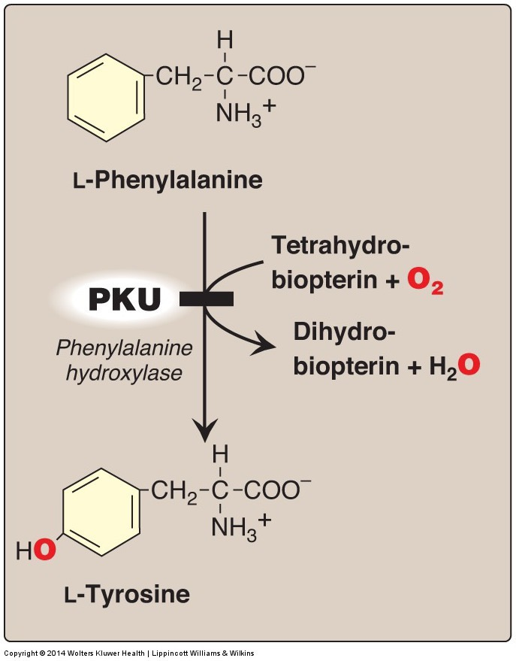
Case Study - PKU
Scenario:
Phenylketonuria (PKU) is genetic disorder resulting in an enzyme deficiency of phenylalanine hydroxylase
After displaying 2 episodes of seizures, a symptom of PKU, Bobbie was diagnosed with PKU
Notes:
Think about his diet, the concept of essential vs nonessential amino acids
Do they need no Phe?
Is Tyrosine Essential for Bobbie?

Slide 29
More about PKU
How would you treat this disorder?
How would you monitor treatment efficacy?
Can Bobbie be treated with a Phe-free diet?
Is Tyrosine essential, nonessential or conditionally essential for Bobbie?

Slide 30
Amino Acid Classification: Essentiality
Phenylalanine (essential) → Tyrosine (nonessential)
Phenylketonuria (PKU) – genetic disorder of enzyme phenylalanine hydroxylase (1/12,000 individuals)
Inability to convert phenylalanine to tyrosine
Phenylalanine builds up
Tyrosine is deficient
Adverse outcomes: seizures, hyperactivity, mental retardation, death
Treatable
Diet low in phenylalanine and high in tyrosine
Tyrosine supplements (“protein substitute”)
Newborns are screened for PKU in all 50 states

Slide 31
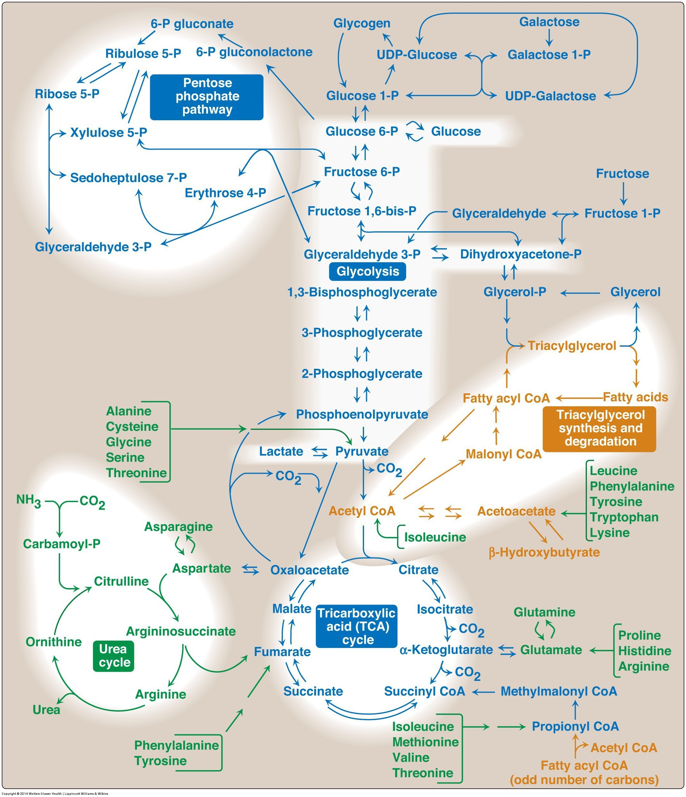
Classification of Amino Acids by Metabolism
Synthesis of glucose, lipids or generation of ATP
What can alanine become? If so under what conditions?
What can leucine become? If so under what conditions?

Slide 32
Glucogenic Amino Acid – Worked Example
Under what conditions would Alanine become glucose
Steps
To form Pyruvate
ALT towards Pyruvate (High Alanine, aKG, low Pyruvate, Glutamate)
To form OAA
High Pyruvate Carboxylase (High Acetyl-CoA)
low Pyruvate Dehydrogenase (High ATP, NADH, low Ca)
To form Glucose
Low Pyruvate Kinase (high Alanine, high ATP, high glucagon)
Low Phosphofructokinase (low F26bp, high Citrate, high ATP, high glucagon)
High Fructose-1,6-bisphosphatase (low F26bp, high ATP, high glucagon)
Summary
High Amino Acids
Alanine
Glutamate
Low Pyruvate from Glucose
High Energy
Acetyl-CoA/Citrate
ATP
NADH
Glucagon

Slide 33
The Ketogenic Amino Acids
Mnemonic:
F - Phenylalanine
L - Leucine
L - Lysine
I - Isoleucine T - Threonine
T - Tryptophan

Slide 34
Protein Structure and Properties Learning Objectives
Apply your knowledge of amino acid biochemistry to explain why proteins are essential macronutrients
Understand the basic structure of protein
Identify the property that makes an amino acid different from another
Describe different functional roles of protein
Identify the major proteins present in food
Differentiate between the different classifications of amino acids
Understand how nonessential amino acids can become essential
Explain the nutritional requirements of collagen synthesis

